Slide 1


Department of BES-I
COURSE: Data Structures
COURSE CODE: 24SC1203
Topic:
Name of the topic:
Priority Queue
Session – 19

Slide 2



AIM OF THE SESSION
To provide a comprehensive understanding of implementing a Priority Queue using linked lists.
INSTRUCTIONAL OBJECTIVES
This Session is designed to:
Demonstrate The Priority Queue
List out the operations possible on the Priority Queue .
Describe each operation
List out the advantages and applications of Priority Queue .
LEARNING OUTCOMES
At the end of this session, you should be able to:
Define Priority Queue
Summarize definition, types and operations of Priority Queue and its applications

Slide 3
Priority Queue
INTRODUCTION
A Priority Queue is a data structure that stores elements with associated priorities, and it retrieves elements in a way that the highest priority element is served before the lower priority elements.
Every node carries one extra information along with the data, that is the priority of the data.

Slide 4
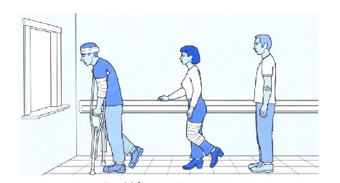
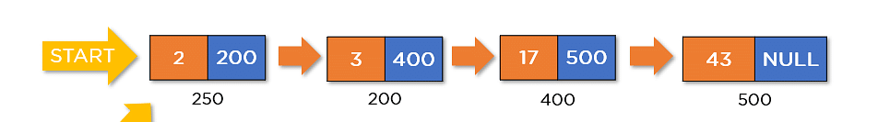
Example of Priority Queue
A Real Life Priority Queue
Priority Queue using linked list

Slide 5
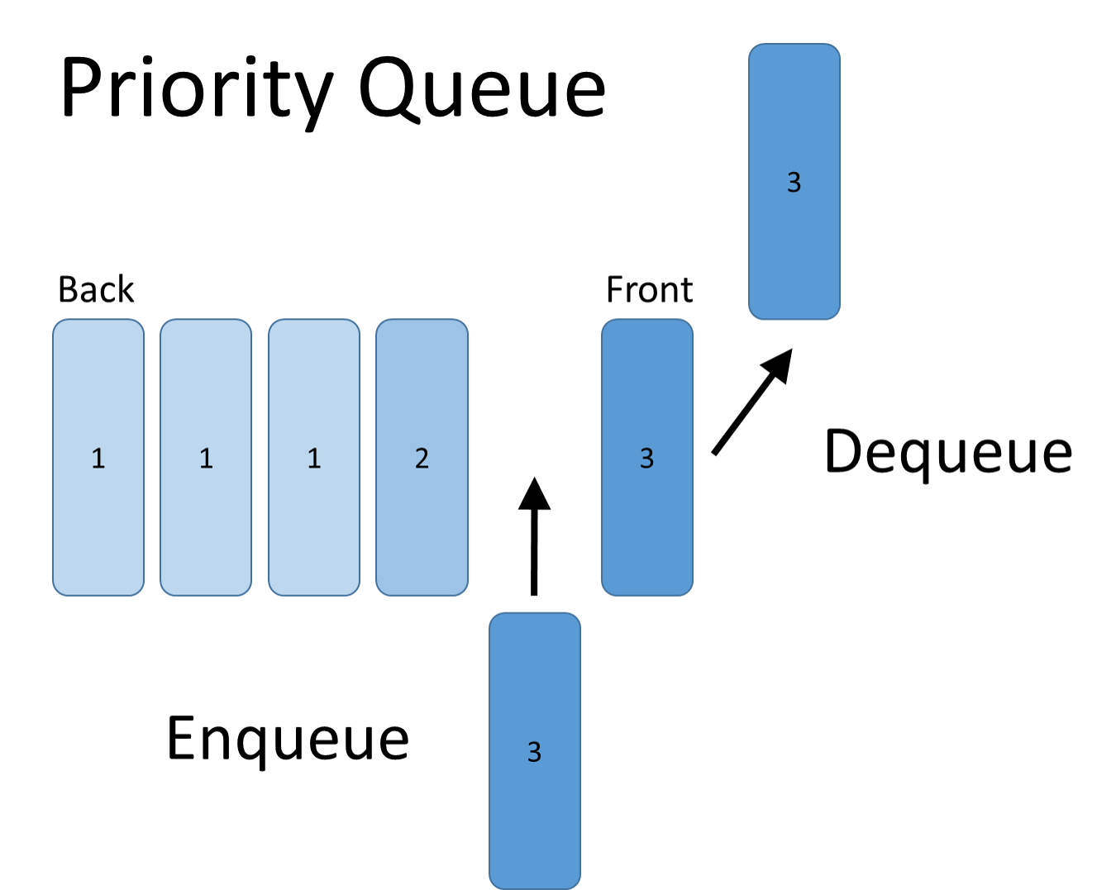
OPERATIONS ON Priority Queue
In a Double Ended Queue, we can perform the following operations...
  Enqueue
  Dequeue
  Display

Slide 6
Setup the Priority using Singly Linked List
Before we implement those operations, first we need to setup empty list.
Perform the following steps to setup Empty Priority Queue:.
Step 1 - Define a Node structure with three members/fields data, priority and next
Step 2 - Define one Node pointer ‘front' and set it to NULL.
Step 3 – Then perform the Operations one by one.
The node is defined (represented) as:
struct Node
{
int data;
int priority;
struct Node * next;
}*front=NULL;
Node
Priority
Data
Next

Slide 7
i) Enqueue in Priority Queue
Original Priority Queue
1
23
4
8
7
15
NULL
Front
After Enqueue of node with data 40 and priority 3
1
23
4
8
7
15
NULL
Front
3
40
NewNode

Slide 8
i) Enqueue in Priority Queue
Algorithm: Enqueue a New Node to a Priority Queue
Input: Priority Queue Front (front), New Node (newNode)
1. If front is NULL (empty priority queue) or the priority of newNode is higher than the priority of the front node:
a. Set newNode's next pointer to front.
b. Set front to newNode.
2. Otherwise, if newNode's priority is lower or equal to the priority of the front node:
a. Initialize a pointer current to front.
b. Traverse the priority queue until current points to the node whose next node has lower priority than newNode.
c. Insert newNode between current and current's next node.

Slide 9
ii) Dequeue in Priority Queue
Original Priority Queue
1
23
3
40
4
8
7
15
NULL
Front
After Dequeue
1
23
3
40
4
8
7
15
NULL
temp
Front

Slide 10
ii) Dequeue in Priority Queue
Algorithm: Dequeue from a Priority Queue
Input: Priority Queue Front (front)
1. If front is NULL (empty priority queue):
a. Print an error message or return an error (nothing to dequeue).
2. Otherwise:
a. Initialize a pointer temp to front.
b. Update front to point to the next node.
c. Free the memory allocated for the node pointed to by temp.

Slide 11
IMPORTANT FACTS RELATED TO THE SESSION
Advantages of a Priority Queue
Efficient Retrieval: Priority queues provide efficient retrieval of the highest-priority element, enabling quick access to the most critical or urgent item in the data structure.
Flexibility in Ordering: Priority queues allow elements to be dynamically ordered based on priority, accommodating various applications where prioritization is essential.
Support for Real-Time Systems: Priority queues are well-suited for real-time systems, ensuring timely processing of high-priority tasks or events, contributing to the responsiveness of the system.
Disadvantages of Priority Queue
Overhead in Sorting: Maintaining the ordered nature of a priority queue can lead to additional overhead in terms of time and space complexity, during insertion and deletion operations.
Limited Random Access: Priority queues lack efficient random access to elements, making it challenging to directly access or modify elements based on their position in the structure.

Slide 12
IMPORTANT FACTS RELATED TO THE SESSION
Applications/Uses of Priority Queue
Task Scheduling in Operating Systems: Priority queues are used to schedule tasks in operating systems, ensuring that higher-priority tasks are executed first, optimizing system responsiveness.
Dijkstra's Shortest Path Algorithm: Priority queues are employed in graph algorithms such as Dijkstra's algorithm to efficiently select and explore the next vertex with the shortest path during traversal.
Job Scheduling in Parallel Processing: Priority queues are utilized in parallel processing systems for job scheduling, enabling the execution of tasks based on priority levels, improving overall system efficiency.

Slide 13
EXAMPLES
These are some real life example of priority queue
Priority Assignment: Patients are assigned priorities based on the severity of their medical condition. For example, a patient with a life-threatening condition like a heart attack may have the highest priority.
Patient Processing : When a medical professional becomes available, they attend to the patient with the highest priority from the front of the queue.

Slide 14
SUMMARY
A priority queue is a data structure that organizes elements based on their associated priorities, allowing for efficient retrieval of the highest-priority element.
It follows a specific order, where elements with higher priorities are served before those with lower priorities.
In a priority queue , we perform the following operations...
i) Enqueue ii) Dequeue iii) Display
The enqueue operation in priority queue is performed on the basis of priority of the data.
The dequeue operation is performed the same way we perform in a regular queue that is, removing the element from front end.

Slide 15
SELF-ASSESSMENT QUESTIONS
Which of the following best describes a Priority Queue??
A data structure that follows First-In-First-Out (FIFO) order.
A data structure that stores elements in a Last-In-First-Out (LIFO) manner.
A data structure that organizes elements based on associated priorities.
A data structure designed for constant time retrieval of any element.
2. In a Priority Queue, how are elements typically arranged?
In ascending order based on their values.
In descending order based on their values.
Based on their insertion order.
Based on their associated priorities, with the highest priority served first.

Slide 16
TERMINAL QUESTIONS
1. Describe About Priority Queue?
2. How a Priority Queue differs from a regular queue?
3. Explain the significance of priority queues in real-time systems.
4. Provide an example scenario where the use of a priority queue is critical for system responsiveness.
5. Compare and contrast the advantages and disadvantages of implementing a priority queue using a linked list versus an array. Consider factors such as time complexity, memory efficiency, and ease of implementation.
6. In the context of an Emergency Room Triage System, explain how a priority queue is employed to manage patient priorities.

Slide 17
REFERENCES FOR FURTHER LEARNING OF THE SESSION
Reference Books:
  Mark Allen Weiss, Data Structures and Algorithm Analysis in C, 2010 , Second Edition, PearsonEducation.
  Ellis Horowitz, Fundamentals of Data Structures in C: Second Edition, 2015
  A.V.Aho, J. E. Hopcroft, and J. D. Ullman, “Data Structures And Algorithms”, Pearson Education, First Edition Reprint2003.
Sites and Web links:
1. https://nptel.ac.in/courses/106102064
2. https://in.udacity.com/course/intro-to-algorithms--cs215
3. https://www.coursera.org/learn/data-structures?action=enroll

Slide 18
THANK YOU
Team – Data Structures

